Slide 1
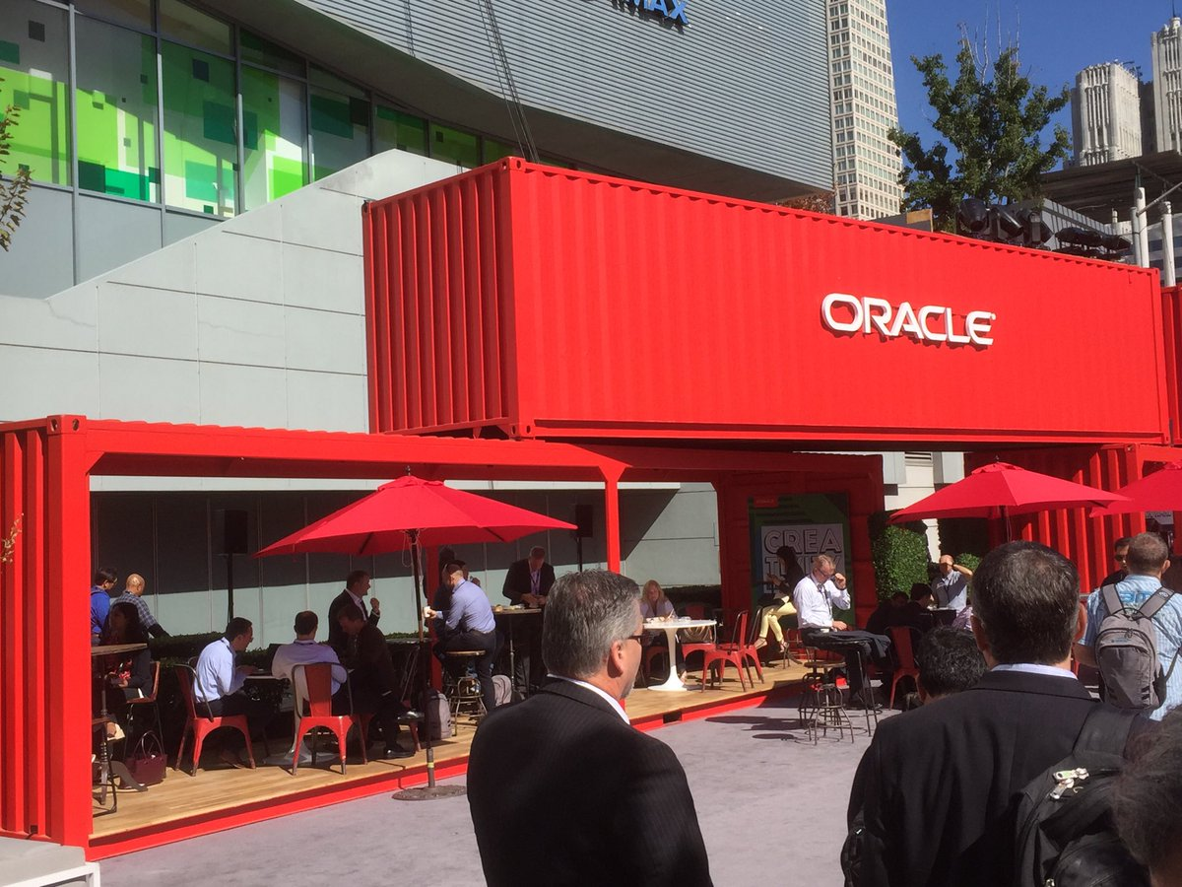
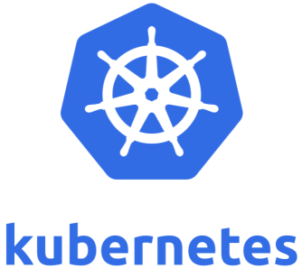
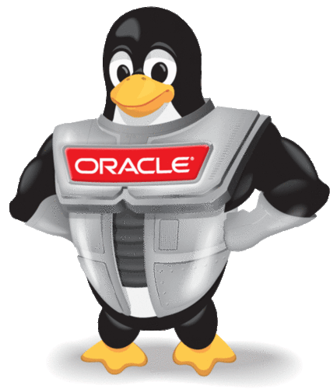
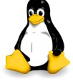

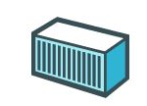
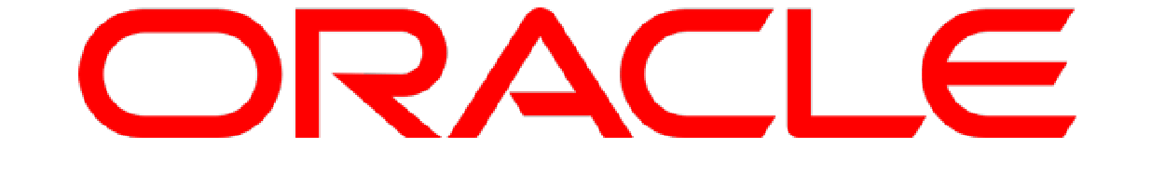
SIG Docker & Kubernetes Part Two
Automation
Run Time Flexibility
TCO
AMIS SIG – 15th July 2019
Eugène van der Voort & Lucas Jellema
Notes:
The microservices architecture promises flexibility, scalability, and optimal use of compute resources.
Via independent components with well-defined scope and responsibility, interface, and ownership that are evolved and managed in an automated DevOps process, this architecture leverages current technologies and hard-learned insights from past decades.
This session demonstrates how to implement, roll out, and manage a set of collaborating microservices on Oracle Cloud, using services such as
container (Docker) and Oracle Application Container Cloud,
event hubs, Oracle Container Engine (Kubernetes),
Oracle Identity Cloud Service,
Oracle Data Hub Cloud Service,
Wercker, Oracle Visual Builder Cloud Service, and Fn serverless platform
and open source tools: Istio, Prometheus, Zipkin, Grafana.

Slide 2
Overview
Scope, Context, Objectives
Introducing Docker Containers (aka VM++)
Light weight, quick start, standardize, distribute, automate, encapsulate
Demo
Oracle and Docker
Oracle products running on Docker & Oracle services around Docker
The search for a container management platform – to do for containers what application servers do for Java Enterprise Applications (and more)
Introducing: Kubernetes
Demo
Ecosystem (CNCF), Resources, Tooling, Roadmap
Oracle and Kubernetes
Workshop

Slide 3
Container Platform (Application Server 2.0)

Slide 4
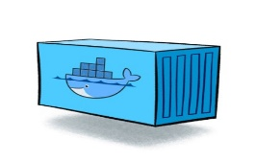
Containers
As vehicle for:
Encapsulate
Build
Share & Ship
Automated Tests
Deploy
Run
Failover
Scale
Load Balance
Relocate
Standardize

Slide 5
Looking for a runtime platform for
Compute Node
Notes:
Deploy and Run (Docker Containers)
Distributed infrastructure (scalable and available)
Hide infrastructure from DevOps teams
Auto-healing
Elastic Scale
Wire up the micros – connect dynamically (service discovery)
Load Balance
Provide Persistent storage
Rolling Upgrade
Configuration & Secret Management
Secure

Slide 6
Looking for a runtime platform for
Compute Node
Compute Node
Compute Node
Notes:
Deploy and Run (Docker Containers)
Distributed infrastructure (scalable and available)
Hide infrastructure from DevOps teams
Auto-healing
Elastic Scale
Wire up the micros – connect dynamically (service discovery)
Load Balance
Provide Persistent storage
Rolling Upgrade
Configuration & Secret Management
Secure

Slide 7
Looking for a runtime platform for
Compute Node
Compute Node
Compute Node
Notes:
Deploy and Run (Docker Containers)
Distributed infrastructure (scalable and available)
Hide infrastructure from DevOps teams
Auto-healing
Elastic Scale
Wire up the micros – connect dynamically (service discovery)
Load Balance
Provide Persistent storage
Rolling Upgrade
Configuration & Secret Management
Secure

Slide 8
Looking for a runtime platform for
Compute Node
Compute Node
Compute Node

Slide 9
Looking for a runtime platform for
Compute Node
Compute Node
Compute Node

Slide 10
Looking for a runtime platform for
Compute Node
Compute Node
Compute Node
Cloud Storage
SAN

Slide 11
Looking for a runtime platform for
Configuration Map
Configuration Map
Compute Node
Compute Node
Compute Node
Cloud Storage
SAN

Slide 12

Looking for a runtime platform for
Compute Node
Compute Node
Compute Node

Slide 13
Looking for a runtime platform for
Compute Node
Compute Node
Compute Node
Compute Node
Compute Node

Slide 14
Looking for a runtime platform for
Compute Node
Compute Node
Compute Node

Slide 15
Looking for a runtime platform for
v2
v2
v2
Compute Node
v2
v2
Compute Node
Compute Node

Slide 17
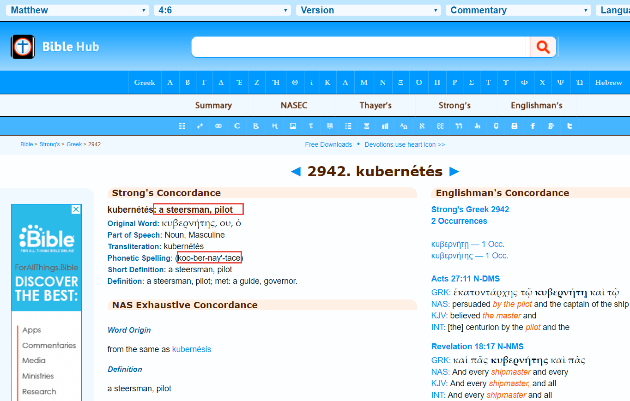

Slide 18
Introducing Kubernetes
Distributed Container Run Time Management platform
Based on Google’s Borg system (in use at Google for over a decade)
Initial announcement: 2014
Kubernetes v1.0 was released on July 21, 2015
A Kubernetes cluster typically spans multiple compute nodes
Either in the cloud, on premises, on a single machine (minikube) or hybrid
K8S manages Pods in which containers are running
K8S schedules Pods on one or more nodes
Docker can be the container runtime; other engines are supported as well, such as rkt and containerd
K8S handles network traffic to, between and from Pods
The kubectl command line interface is used for most management activities

Slide 19
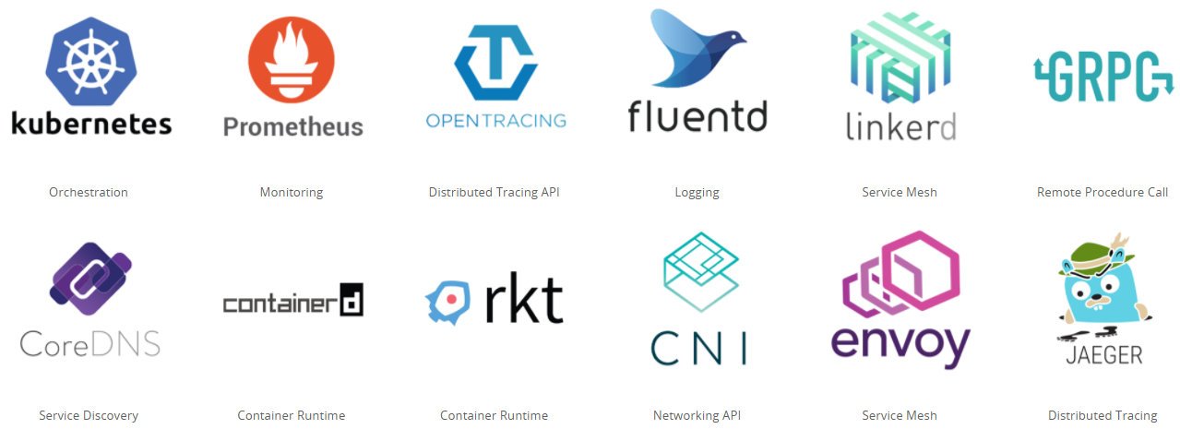
Cloud Native & Vendor Neutral
Cloud Native Computing Foundation - CNCF
All major – and not so major – vendors are member
Cloud Native: container packaged, dynamically managed, microservices oriented
Open technology for running container based workloads in a cross cloud vendor neutral way
Notes:
https://www.cncf.io/

Slide 20
Kubernetes
The application and microservices runtime platform of tomorrow
Notes:
https://cloud.oracle.com/container-classic

Slide 21
Key constituents of Kubernetes
pod
cluster
Compute Node
container
Compute Node
Compute Node
Kubernetes

Slide 22
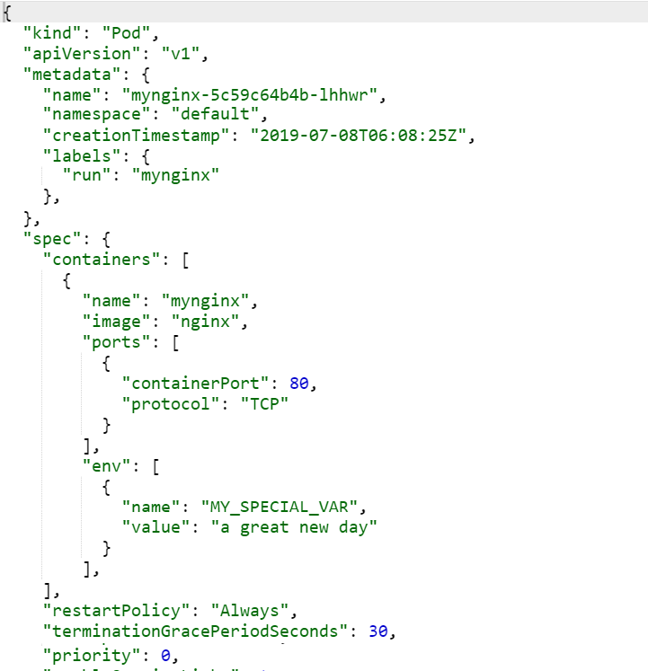
Key constituents of Kubernetes
pod
cluster
Compute Node
container
Compute Node
Compute Node
Kubernetes

Slide 23

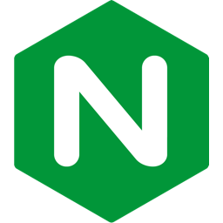
Demo: Run NGINX on Kubernetes
kubectl run mynginx --image=nginx --port=80 --env="MY_SPECIAL_VAR=a great new day"
Docker Hub
pod
cluster
80
MY_SPECIAL_VAR= a great new day
Compute Node
container
Compute Node
Compute Node
Kubernetes

Slide 24
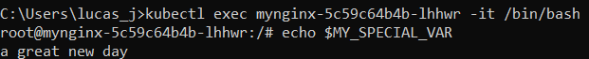
Demo: Run NGINX on Kubernetes
kubectl get pods
kubectl exec -ti nginx-<POD_ID> -- /bin/sh
echo $MY_SPECIAL_VAR
pod
80
MY_SPECIAL_VAR= a great new day
Compute Node
container
Compute Node
Compute Node
Kubernetes

Slide 25
Key constituents of Kubernetes: Service
Some external consumer
pod
cluster
service
Compute Node
container
service
Compute Node
Compute Node
Kubernetes

Slide 26
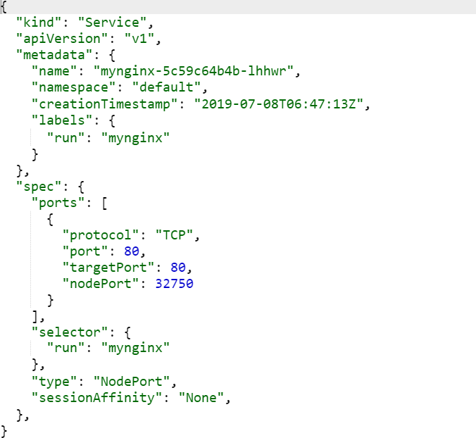
Key constituents of Kubernetes
pod
cluster
service
Compute Node
container
service
Compute Node
Compute Node
Kubernetes

Slide 27
Demo of Exposing a Pod through a Service
kubectl expose pod mynginx-5c59c64b4b-lhhwr
--port=80 --type=NodePort
Some external consumer
pod
cluster
service
Compute Node
container
80
service
Compute Node
Compute Node
Kubernetes

Slide 28
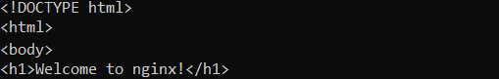
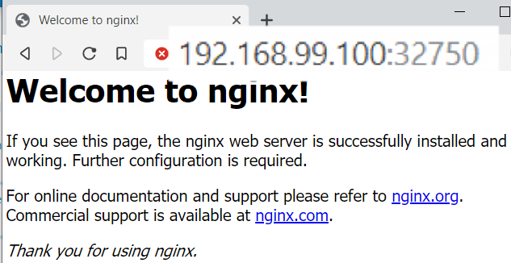
Demo of Exposing a Pod through a Service
kubectl get svc
curl 192.168.99.100:32750
pod
cluster
service
Compute Node
container
80
service
Compute Node
Compute Node
Kubernetes

Slide 29
Key constituents of Kubernetes
deployment
pod
service
Compute Node
pod
Compute Node
Compute Node
Kubernetes
cluster

Slide 30
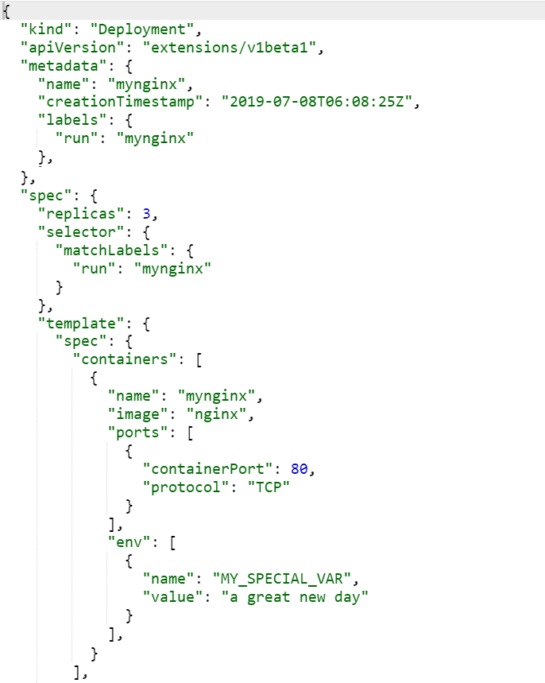
Key constituents of Kubernetes
deployment
pod
service
Compute Node
pod
Compute Node
Compute Node
Kubernetes
cluster

Slide 31
Demo of Deployment
Observe load balancing
Delete Pod
Change Scaling
deployment
pod
service
Compute Node
pod
Compute Node
Compute Node
Kubernetes
cluster

Slide 32
Key constituents of Kubernetes
namespace
namespace
service
Compute Node
service
Compute Node
Compute Node

Slide 33
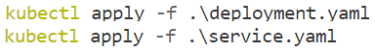
Demo of Scripted Resource Management
kubectl apply –f <file | directory >
Deployment mynginx
Namespace nginx
service
Service mynginxservice
Kubernetes
cluster

Slide 34
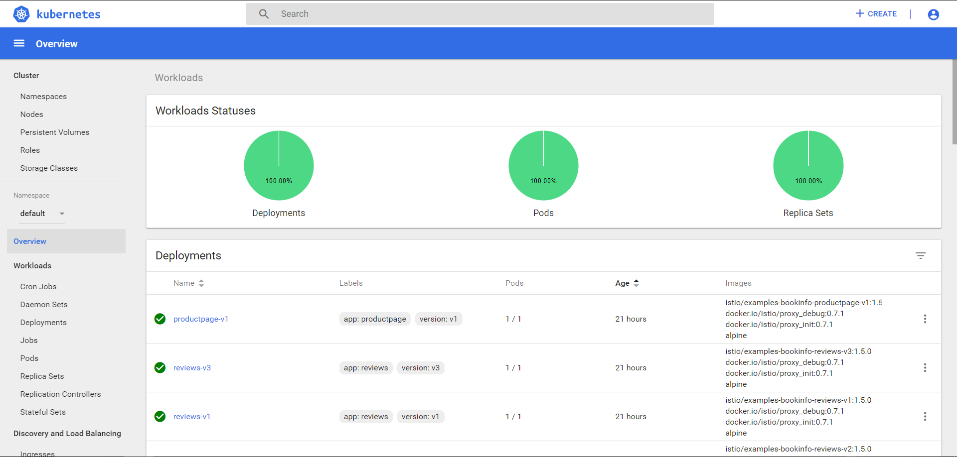

Slide 35
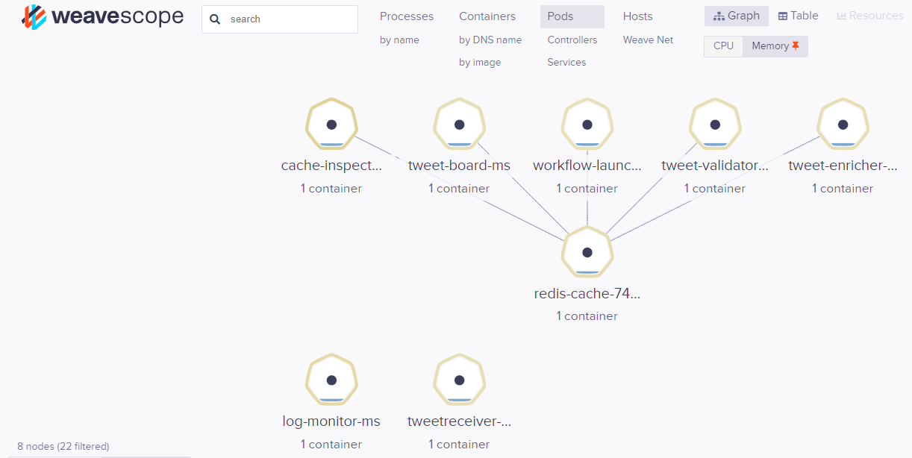
Visualizing Kubernetes Resources with WeaveScope

Slide 36
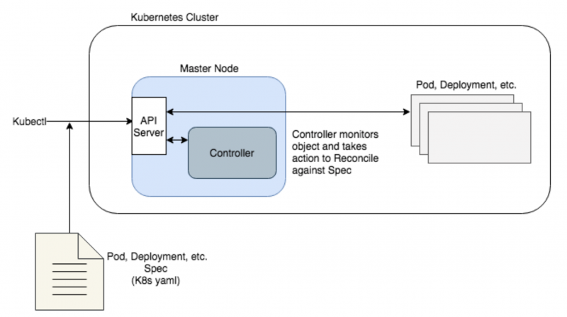
One way of looking at Kubernetes
Kubernetes is essentially a desired state manager.
You give it a desired state for your application (number of instances, disk space, image to use, etc.) and it attempts to maintain that state should anything get out of wack.
Kubernetes uses what’s called a control plane on it’s master node. The control plane includes a number of controllers whose job is to reconcile against the desired state in the following way:
Monitor existing K8s objects (Pods, Deployments, etc.) to determine their state
Compare it to the K8s yaml spec for the object
If the state is not the same as the spec, the controller will attempt to remedy this

Slide 37
Key constituents of Kubernetes: Volume
deployment
pod
service
Compute Node
pod
Compute Node
Compute Node
Kubernetes
cluster
volume

Slide 38
Volume and Volume mount
volumeMount
Volume is associated with a Pod
Lives as long as the Pod it is associated with
Data is preserved across container restarts
It is not meaningful across Pods or even Pod restarts
Use PeristentVolume and PersistentVolumeClain
Accessible to all containers in the Pod
Mounted at specific points in each container
Multiple types of Volumes
emptyDir (local file cache), hostPath (on local Node), local
nfs, iscsi, storageOS, vSphere, cephfs, cinder (OpenStack)
awsElasticBlockStore, azureDisk, azureFile, gcePersistentDisk
secret, configMap
persistentVolumeClaim
volumeMount
volume

Slide 39
Key constituents of Kubernetes: PersistentVolume & PersistentVolumeClaim
deployment
pod
VolumeMount
VolumeMount
service
PersistentVolume
Compute Node
Volume
Volume
Compute Node
PersistentVolumeClaim
Compute Node
Kubernetes

Slide 40
PersistentVolume and PersistentVolumeClaim
VolumeMount
PersistentVolume is a piece of storage, independently created based on a StorageClass
Pod independent life cycle
PVs can be used by multiple Pods
PVs can be created ahead of time or dynamically from PVC
A PersistentVolumeClaim is a one-to-one binding of a volume of the right type and size and with an access mode (read, readWrite, …)
Pods use PVCs through a Volume
Mount Volume inside containers in the Pod
PVC creation can trigger PV creation – or can map to existing PV
Multiple types of PersistentVolume
HostPath (for single node testing only), minikube standard (i.e. local in VM)
nfs, iscsi, storageOS, vSphere, cephfs, cinder (OpenStack)
awsElasticBlockStore, azureDisk, azureFile, gcePersistentDisk
PersistentVolume
Volume
PersistentVolumeClaim
AMIS SIG Introduction Docker & Kubernetes

Slide 41
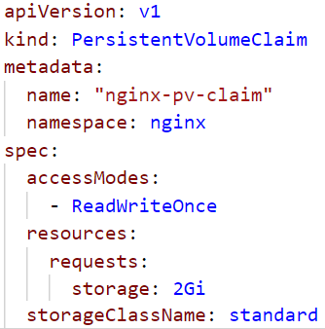
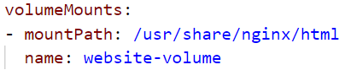
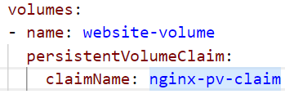
Demo of PersistentVolume & PersistentVolumeClaim
VolumeMount
service
PersistentVolume
is auto generated
Volume
PersistentVolumeClaim
nginx-pv-claim
Minikube VM

Slide 42
Demo of PersistentVolume & PersistentVolumeClaim
kubectl cp ./index.html mynginx-7b87c957dd-br2kr:/usr/share/nginx/html -n=nginx
VolumeMount
service
PersistentVolume
is auto generated
Volume
PersistentVolumeClaim
nginx-pv-claim

Slide 43
Demo of PersistentVolume & PersistentVolumeClaim
kubectl delete deployment mynginx -n=nginx
VolumeMount
service
PersistentVolume
is auto generated
Volume
PersistentVolumeClaim
nginx-pv-claim

Slide 44
Demo of PersistentVolume & PersistentVolumeClaim
kubectl apply –f deployment-v2.yaml
VolumeMount
service
PersistentVolume
is auto generated
Volume
PersistentVolumeClaim
nginx-pv-claim

Slide 45
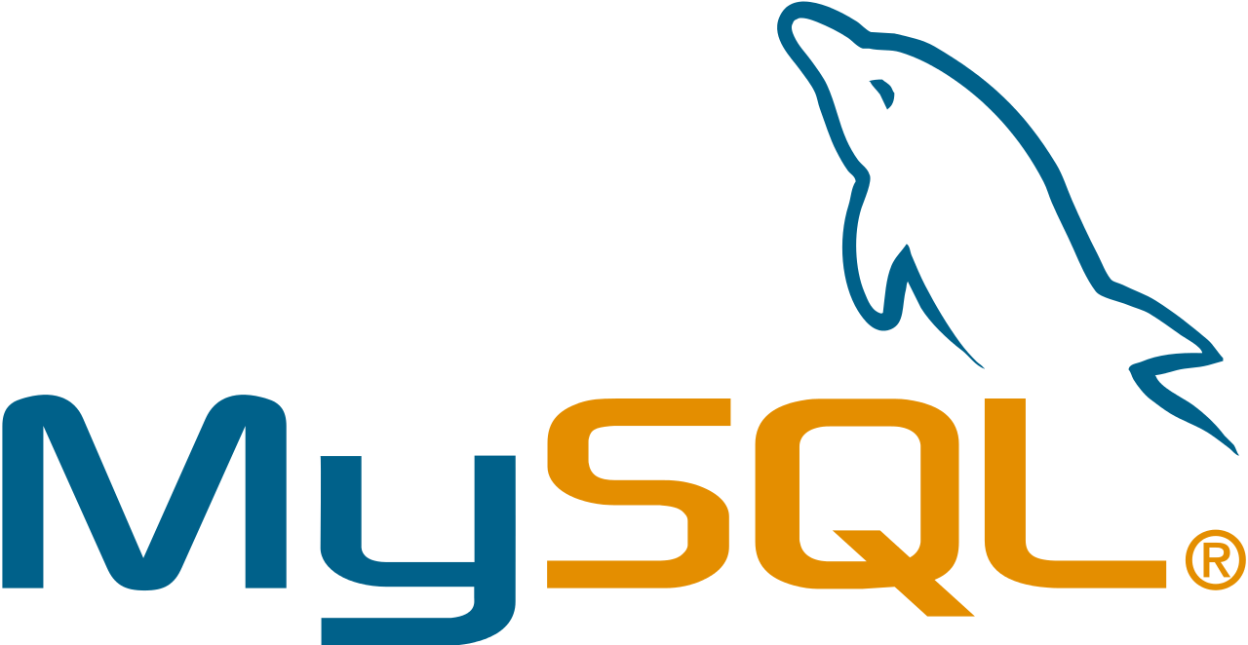

Demo Wordpress & MySQL on Kubernetes
namespace
deployment
All Wordpress related resources are defined in a single namespace
Deploy as two Pods with one Container each
Use Deployments for automatic fail over
Expose Wordpress through a Service
deployment
service
pod

Slide 46
Demo Wordpress & MySQL on Kubernetes
namespace
deployment
All Wordpress related resources are defined in a single namespace
Deploy as two Pods with one Container each
Use Deployments for automatic fail over
Expose Wordpress through a Service
Use a Persistent Volume for the MySQL data files
Use Secret for sensitive configuration settings such as MySQL password
deployment
service
pod
VolumeMount
VolumeMount
PersistentVolume
password
Volume
Volume
PersistentVolumeClaim
Secret

Slide 47
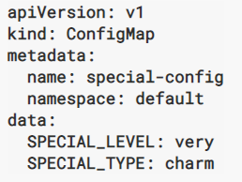
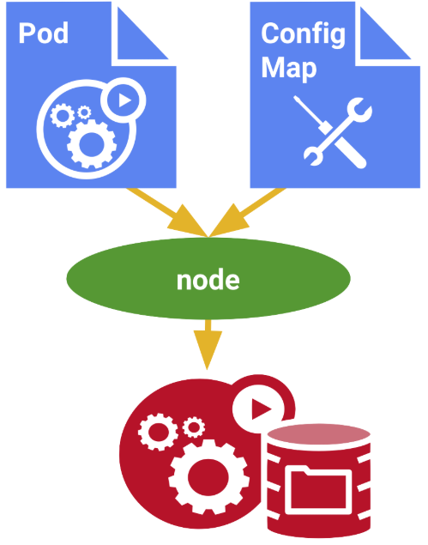
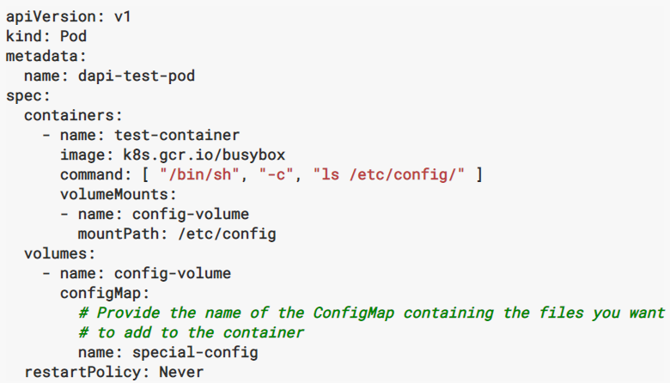
ConfigMap – to provide environment specific values to K8S Resources
A ConfigMap is a K8S resource
It contains keys and values
Other Resource definitions (Pod, Deployment, …) can refer to keys in the ConfigMap to make them environment independent
Yet make use of environment specific settings
A ConfigMap can also be mounted as a Volume and be accessed like a mounted disk inside Pods

Slide 48
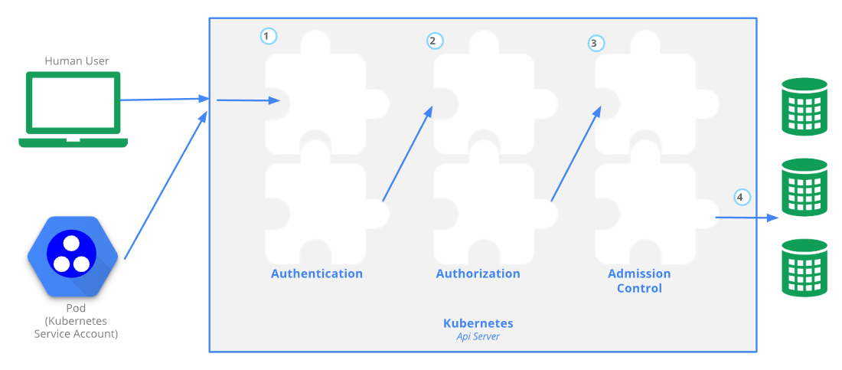
Access Control
Access to Kubernetes APIs is protected through
TLS
Authentication – tokens (JWT, OpenID Connect, …), certificates, basic authentication
Role Based Authorization
Admission Control Modules
Comparable to Servlet Filters or Oracle DB DML Triggers

Slide 49
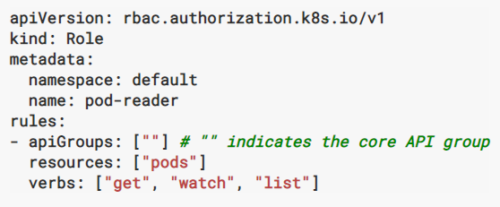
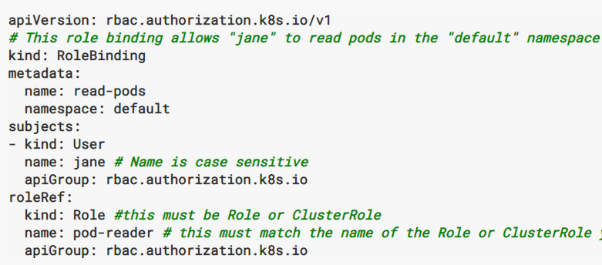
Role Based Access Control (RBAC)
Roles (within namespace) and ClusterRole (cluster wide) are sets of permissions that define access to K8S Resources
RoleBinding and ClusterRoleBinding associate a Role or ClusterRole with a User or set of Users

Slide 50
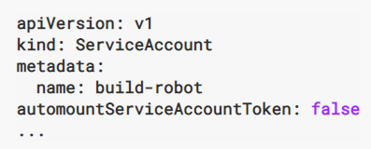
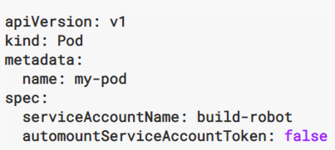
Role Based Access Control (RBAC)
Groups are sets of users
Roles can be granted to groups just as to users
Services Accounts
A service account provides an identity for processes that run in a Pod
And indirectly determines the access rights from within the Pod
When a Pod is created, it is assigned the default Service Account – unless a specific Service Account is specified
Usernames system:service-account:service-account-name
Default ClusterRole and ClusterRoleBinding objects are created out of the box
As well as system groups: system:authenticated and system:unauthenticated
Notes:
https://kubernetes.io/docs/reference/access-authn-authz/rbac/

Slide 51
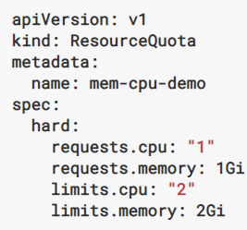
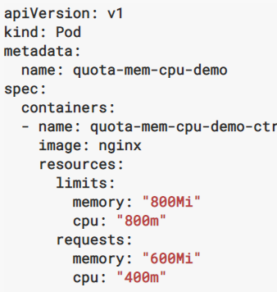
Resource Quota to govern the usage of physical cluster resources
Resource Quota define upper levels of physical resource usage for all resources in a namespace combined
CPU and Memory constraints
Per Pod – a limit can be specified for CPU and Memory usage by all containers in the Pod
The resource request indicates the minimum resource consumption required for the Pod to be successfully started
A LimitRange resource is created per Namespace to specify default upper and lower limits for all containers running in the namespace
Notes:
https://kubernetes.io/docs/tasks/administer-cluster/manage-resources/memory-constraint-namespace/

Slide 52

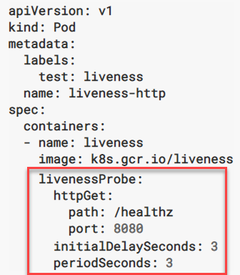
Health Probes to test for Readiness and Liveness
kubelet
Liveness probe
Readiness probe
Health probes are defined on containers in a Pod
Readiness: Check to determine if Pod is ready to receive requests (if not, do not send traffic its way)
Liveness: Check if Pod is still alive (and if not, start a fresh one and discard the unhealthy one)
Probe can take various forms
Shell script to be executed on container - check for success code to be returned from the script
HTTP request to be sent to container – check for 200 <= HTTP status code < 400
TCP Request to socket on container
Probe has properties initialDelaySeconds and periodSeconds
To cater for container startup time before the first readiness check is performed and to determine the ‘polling interval’
container
Pod

Slide 53
Rolling Upgrade of Applications
kubectl apply –f deployment-v2.yaml
Upgrade Application to new version of an Image – while staying available
The steps:
Application must run multiple Pods
Upgrade is done one Pod at a time:
New Pod is added with the new version
When the new Pod is Alive and Ready, one old Pod is removed
If the new Pod does not start successfully, then the upgrade is stopped
Then the next new Pod is created
Etc.
If a Deployment is exposed publicly, the Service will load-balance the traffic only to available Pods during the update.

Slide 54
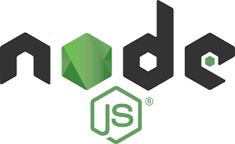
Demo of Rolling Upgrade and use of Health Probes
sharks-app:2.0
Docker Hub
kubectl apply –f deployment-v2.yaml
sharks-app:1.0
Deployment
kubelet
RC
service
sharks-app:1.0
sharks-app:1.0
sharks-app:1.0

Slide 55
Demo of Rolling Upgrade and use of Health Probes
sharks-app:2.0
Docker Hub
kubectl apply –f deployment-v2.yaml
sharks-app:1.0
Deployment
sharks-app:2.0
kubelet
RC
RC
service
sharks-app:1.0
sharks-app:1.0
sharks-app:1.0

Slide 56
Demo of Rolling Upgrade and use of Health Probes
sharks-app:2.0
Docker Hub
kubectl apply –f deployment-v2.yaml
sharks-app:1.0
Deployment
sharks-app:2.0
sharks-app:2.0
kubelet
RC
RC
service
sharks-app:1.0
sharks-app:1.0

Slide 57
Demo of Rolling Upgrade and use of Health Probes
sharks-app:2.0
Docker Hub
kubectl apply –f deployment-v2.yaml
sharks-app:1.0
Deployment
sharks-app:2.0
sharks-app:2.0
sharks-app:2.0
kubelet
RC
RC
service
sharks-app:1.0

Slide 58
Other Kubernetes topics
Job and CronJob
Create one [or more] Pods to run and successfully complete a workload
Use CronJob to schedule a Job according to a Cron type time schedule
Taint and Tolerations
Settings on Node (taint) and Pod (toleration) to steer onto which cluster nodes a Pod is scheduled
DaemonSet
a special type of Pod – that is guaranteed to run on every node of the Kubernetes Cluster; when a node is added, the DaemonSet Pod is started on that node
Pod Priority
Priority settings to increase changes for Pod of being scheduled – possibly at the cost of other Pods

Slide 59
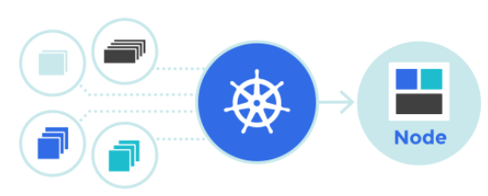
And more
Ingress – reverse proxy, edge router – “gateway to the K8S Cluster”
Ingress can provide load balancing, SSL termination and name-based virtual hosting routing to services
Implemented using HAproxy, nginx, Traefik, Kong
Service Catalog & Service Brokers
Discover and hook into managed cloud services that live outside K8S (“Cluster meets cloud”)
Custom Resource Definitions and Custom Controller
define custom object types to be defined on top of Kubernetes
and logic (in go) to implement the desired state of these custom resources

Slide 60

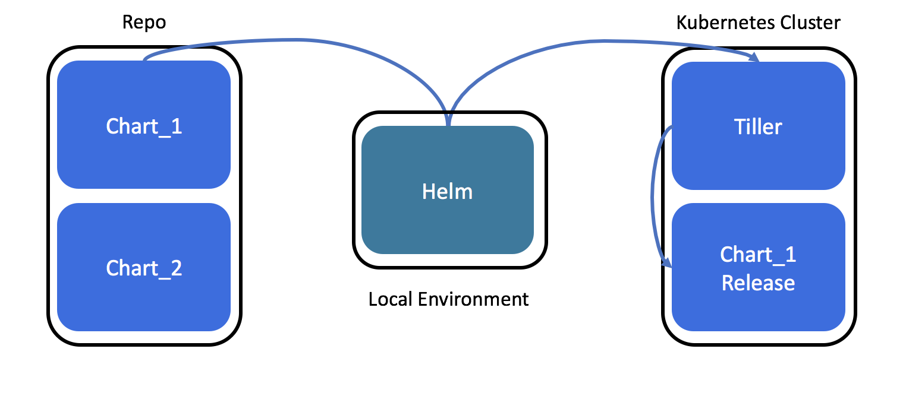
Helm: The Kubernetes Package Manager
Use Helm for
Find and use popular software packaged as Helm charts to run in Kubernetes
Share your own applications as Helm charts
Create reproducible builds of your Kubernetes applications
Intelligently manage your Kubernetes manifest files
Manage releases of Helm packages
Helm Charts are packages with K8S Resource Definitions
Configured together to constitute meaningful applications
Somewhat similar to Docker Compose
Helm is a client that collaborates with Tiller – a server component installed on a Kubernetes Cluster

Slide 61
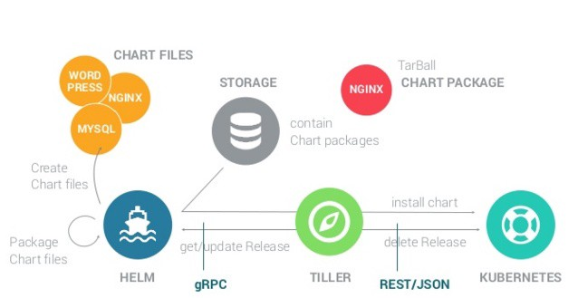
Helm Architecture

Slide 62
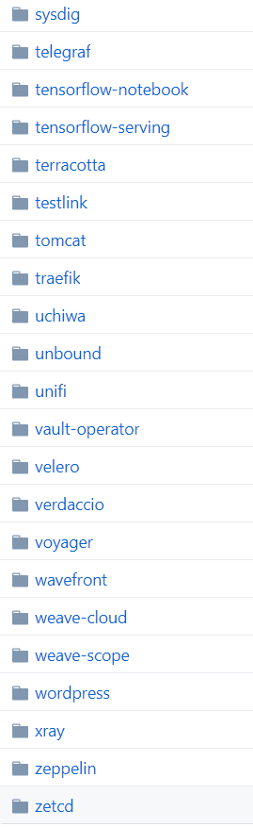
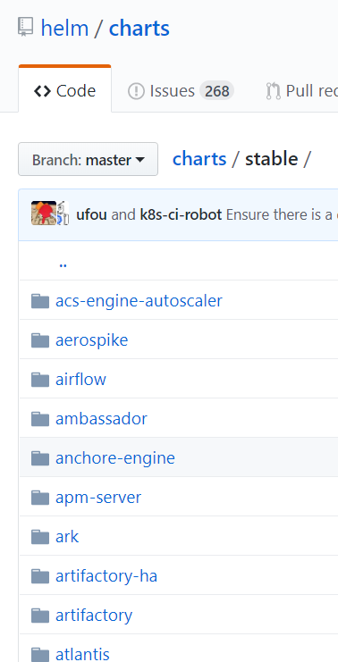
Helm Chart Repository
Hundreds of applications have been packaged as Helm Chart
The Helm client can be fed Repository locations and gather Chart definitions from them
A simple helm install command suffices to install a chart into a K8S Cluster
It replaces manually running many kubectl apply commands (in exactly the right order)
It replaces detailed instructions for manually running kubectl commands

Slide 63
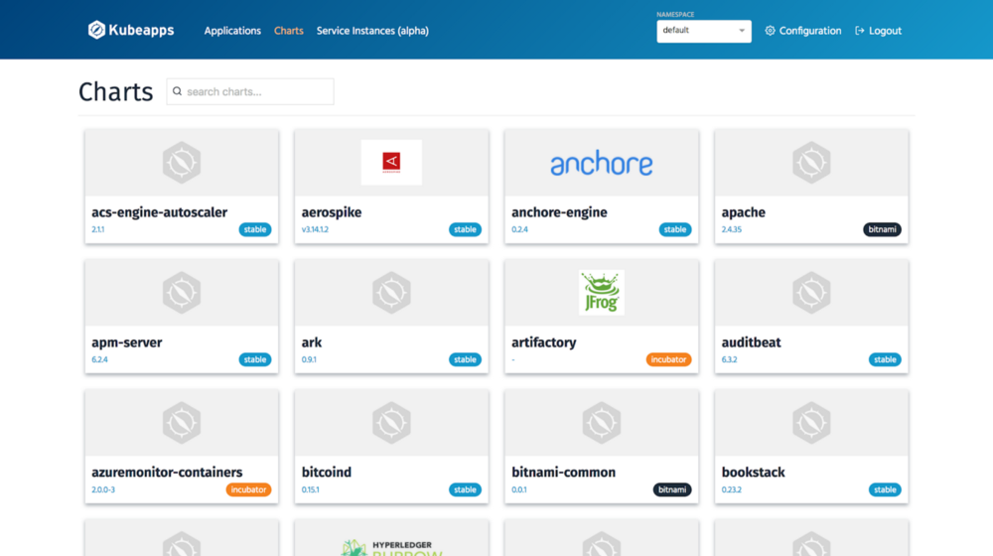
KubeApps - Self Service Portal for K8S Users
Kubeapps is a web-based UI for deploying and managing applications in Kubernetes clusters. It allows your cluster users to deploy applications packaged as Helm charts directly from their browsers.
https://kubeapps.com/

Slide 64
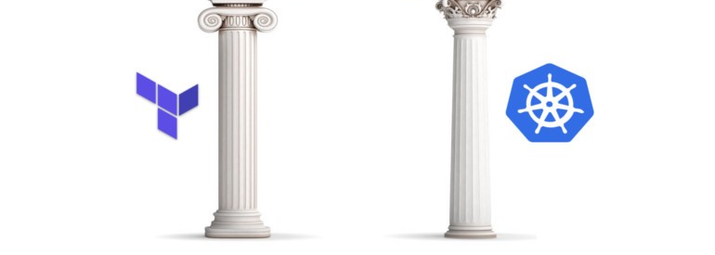
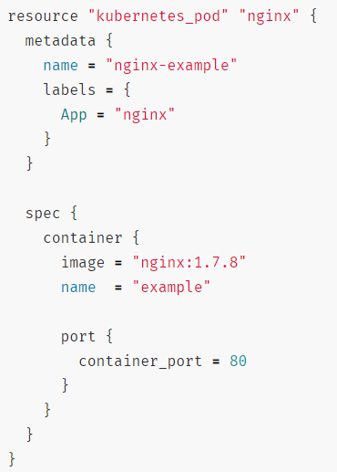
Terraform and Kubernetes
Terraform can be used to
Provision the Kubernetes Cluster infrastructure
Provision Kubernetes resources required for specific applications
Terraform has a Kubernetes Provider – that converts Terraform configurations into K8S validations, optimizations and API calls
Benefits of using Terraform for K8S:
Use Terraform for all types of infrastructure: one way to describe desired state across all clouds & stacks
Drift detection
Full life cycle management (create, update & delete)
Synchronous feedback
Dependency interpretation & smart scheduling
Notes:
https://www.terraform.io/docs/providers/kubernetes/guides/getting-started.html

Slide 65
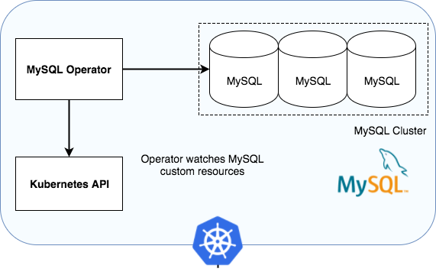
Kubernetes Operator
A fully automated, managed way of deploying, running and evolving an application on Kubernetes – using Kubernetes constructs and APIs
Now also referred to as Kubernetes Native (aka Knative) Application
Operators extend Kubernetes
Operators systematize human knowledge about an application life cycle as code and thus encapsulate compexity and abstract details
Operators can scale and repeat application lifecycle actions

Slide 66
Remember Kubernetes as the Desired State Manager?
Kubernetes is essentially a desired state manager.
You give it a desired state for your application (number of instances, disk space, image to use, etc.) and it attempts to maintain that state should anything get out of wack.
Kubernetes uses what’s called a control plane on it’s master node. The control plane includes a number of controllers whose job is to reconcile against the desired state in the following way:
Monitor existing K8s objects (Pods, Deployments, etc.) to determine their state
Compare it to the K8s yaml spec for the object
If the state is not the same as the spec, the controller will attempt to remedy this

Slide 67
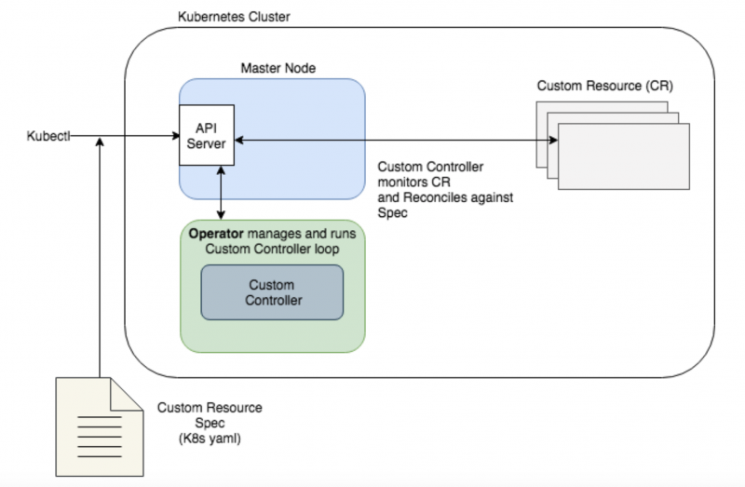
Kubernetes Operator leverages Custom Resources and Custom Controller through standard Kubernetes APIs
Kubernetes allows Custom Resource Definitions to be defined
Your own type of resource, next to Pod, Deployment and Service
Operators encapsulate the logic to turn the definition of a Custom Resource into real K8S objects that run, handle requests and execute logic
As well as provide monitoring insight and automated management
Operators do not so much deploy an application (like Helm) but take full, automated control over running the application

Slide 68
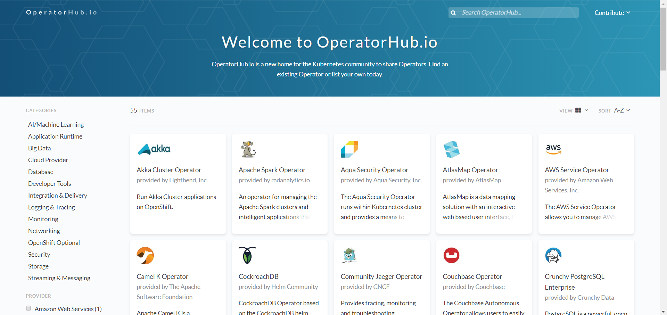
Kubernetes Operator
Repository of Operators - https://operatorhub.io/

Slide 69
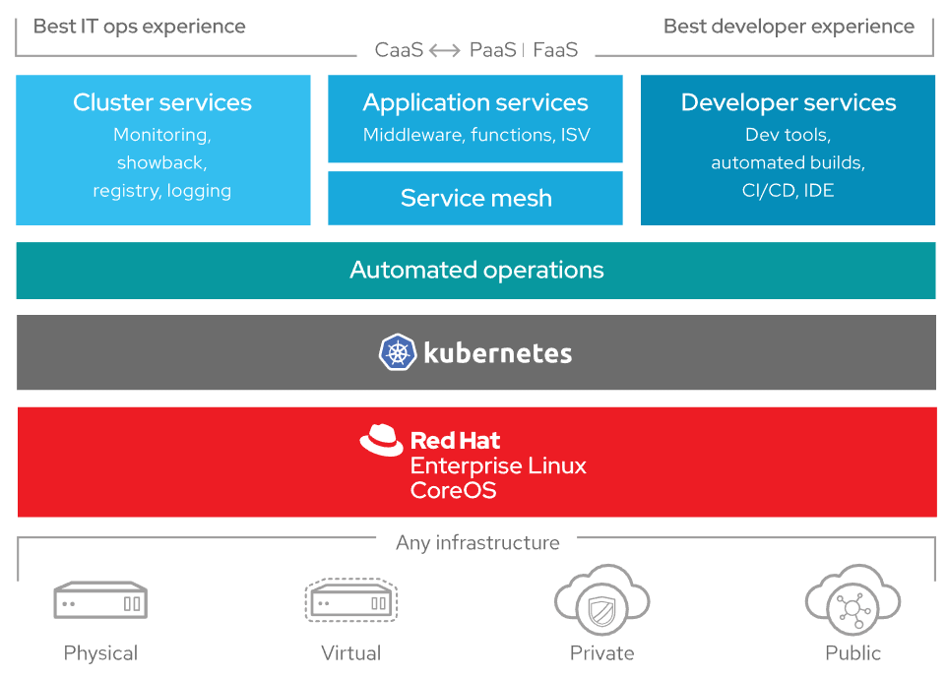
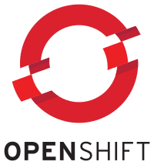
OpenShift by RedHat a hybrid cloud, enterprise Kubernetes application platform

Slide 70

Service Mesh (and how to not get into a sevice mess)

Slide 71



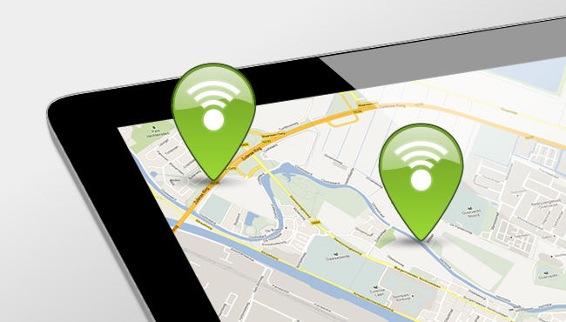




Microservice Runtime Platform - plus
Notes:
Monitor
Health
Load/performance
Tracing
Collect metrics & logs for analysis
Route
A/B, Canary, Authorize/Policy Enforcement, Protocols
Circuit Breaker, Throttle (Rate Limiting)
Mirror traffic for asynchronous testing
Security
TLS
Access control – whitelist/blacklist,

Slide 73








Istio – Service Mesh Operations
Routing
Access Control
Whitelist/Blacklist
Security
TLS
Resilience
Rate Limiting & Circuit Breaker
Monitoring
Trace
Service Graph

Slide 74



Slide 75
Envoy Sidecar
http(s), tcp,gRPC
Pod
Envoy Sidecar
Metrics, trace, policy checks
Istio Mixer
Configuration
Istio Pilot
TLS Certificates
Istio Auth
Notes:
Docker container
Injected into Pod
Handles all inbound/outbound traffic
Guided by Pilot
Reporting to Mixer

Slide 76

Kubernetes and Oracle Kubernes Engine Cloud
The application and microservices runtime platform of tomorrow
Notes:
https://cloud.oracle.com/container-classic

Slide 77

Oracle and Kubernetes
Oracle joined CNCF
Summer of 2017
Oracle launched Oracle Cloud Container Services
Kubernetes Engine on top of OCI
Spring of 2018
K8S Cluster on OCI Infra
You only pay for OCI Infra – no surcharge for K8S facilities
Container Registry
Future of WebLogic is fully on Kubernetes
Future of Application Container Cloud is on Kubernetes

Slide 78
Introducing Container Engine for Kubernetes - OKE
What is It?
Managed Kubernetes container service to deploy and run your own container based apps
Tooling to create, scale, manage & control your own standard Kubernetes clusters instantly
What Problems Does it Solve?
Too complex, costly and time consuming to build & maintain Kubernetes environments
Too hard to integrate Kubernetes with a registry and build process for container lifecycle management
Too difficult to manage and control team access to production clusters
Key Benefits
Enables developers to get started and deploy containers quickly. Gives DevOps teams visibility and control for Kubernetes management.
Combines production grade container orchestration of open Kubernetes, with control, security, IAM, and high predictable performance of Oracle’s next generation cloud infrastructure
Notes:
Formal name: Oracle Cloud Infrastructure Container Engine for Kubernetes
Enables developers to get started and deploy containers quickly, DevOps teams with Kubernetes management, visibility and control.
Combines production grade container orchestration of open Kubernetes, with control, security and high predictable performance of Oracle’s next generation OCI cloud infrastructure

Slide 79


Slide 80


Slide 81




Oracle Cloud Infrastructure Application Platform
Enterprise Applications
Cloud Native Applications Micro Services, Big Data, AI/ML
Cloud Applications
Database Cloud
Cloud Platform
Hypervisors
Container Services
Application Services
Oracle RDBMS, Oracle RAC, Exadata
Java, Big Data, Mobile, Integration Services
Run VMWare / KVM
Docker, Kubernetes, Serverless Functions
Monitoring and Management
Streaming and Pipelines
Developer Tools
DevOps Tools and Services
Next Layer Services
Cloud Infrastructure
25 GB Network
Bare Metal
VM
GPU
NVMe SSD
Block Storage
File Storage
Object Storage
Core Services

Slide 82


Slide 83


Detail: OCI Container Engine for Kubernetes and Registry An Open, Fully-Managed Kubernetes Platform & Private Registry
Container Native: Standard Upstream Kubernetes; Fully Managed Lifecycle; Integrated Registry
Developer Friendly: Simple, Streamlined User Interface; REST API; Helm, and DNS Built-in
Enterprise Ready: Oracle Cloud Infrastructure Performance; Highly Available; Secure with OCI Access Controls
Build
Test
Test
Test
Push
Any CI/CD - ie Jenkins, Oracle Pipelines, etc.
OCI Registry
OCI Container Engine for Kubernetes
VCN
AD 1
AD 3
AD 2
Exposed Kubernetes Service
LB
PV
K8S Cluster
VM
Node Pool
Pods
Node Pool
BM

Slide 84
Oracle Container Engine & Registry
Container Native
Developer Friendly
Enterprise Ready
Standard Docker & Kubernetes
Deploy standard & open upstream Docker and Kubernetes versions for compatibility across environments
Registry Integration
Full Docker v2 compatible private registry to store and manage images
Container Engine
Deploy and operate containers and clusters
Full integration to cloud networking and storage
Leverage the enterprise class networking, load balancing and persistent storage of Oracle Cloud Infrastructure
Streamlined Workflow
Use your favorite CI/CD to push containers to the registry, then Kubernetes to deploy to clusters and manage operations
Full REST API, CLI, Terraform
Automate the workflow, create and scale clusters through full REST API, CLI and Terraform
Built In Cluster Add-Ons
Kubernetes Dashboard, DNS & Helm
Open Standards
Docker Based Runtime
Worker Node SSH Access
Standard Conformant Kubernetes
Simplified Cluster Operations
Use the fully managed, highly available registry, master nodes and control plane
Full Bare Metal Performance and Highly Available IaaS
Combine Kubernetes with bare metal shapes for raw performance
Deploy Kubernetes clusters across multiple Availability Domains for resilient applications
Team Based Access Controls
Control team access and permissions to clusters
Autonomous Clusters
Maintain cluster size and performance in face of node failures and load fluctuations
Notes:
s

Slide 85

Planned ACCS Updates
EARLY DESIGN PHASE
Build as OCI-native service
Built on top of Kubernetes Platform Services
We handle deployment, keeping it running and provide logs and curated set of metrics
Provide service bindings to other services inside or outside of OCI
Support “bring your runtime” and “create your container from source” scenarios

Slide 86

Notes:
https://static.rainfocus.com/oracle/oow18/sess/1524241203677001mTqC/PF/WLS_Coh_K8S_PRO4402_1540510013350001kPbs.pdf

Slide 87


Slide 88


Slide 89


Slide 90
Summary
IT has to enable business objectives
Needs to be flexible – regarding function and non-functional requirements
Operational focus has to be on the combination of application and platform
No one pays for a running platform & infrastructure as such!
Development focus has to be on the combination of application and platform
And on making functionality work for the business objectives
DevOps is the merging of minds on these shared goals: Application & Platform form a single entity that has to run in production to have any value at all
Containers and the Kubernetes platform enable DevOps, microservices and automation of application and platform/infrastructure management
Automated build and delivery, scalable, automated recovery and roll out, smart routing
Increasingly relevant: Cloud Native, Service Mesh, Serverless

Slide 91




Contact Details
Blog: technology.amis.nl
Email: lucas.jellema@amis.nl
: lucasjellema
: lucas-jellema
: www.amis.nl, info@amis.nl +31 306016000 Edisonbaan 15, Nieuwegein

Slide 93


